Slide 1
POWERPOINT ON DIIVISION ALGORITHM
BY- ADITYA SHARMA

Slide 2
DIVISION ALGORITHMS
Division of two fixed point binary numbers in signed magnitude representation is done with paper and pencil by a process of successive compare, shift and subtract operations.
Binary division is simpler than decimal division because quotient digits are either 0 or 1 and there is no need to estimate how many times the dividend or partial remainder fits into the divisor.

Slide 3
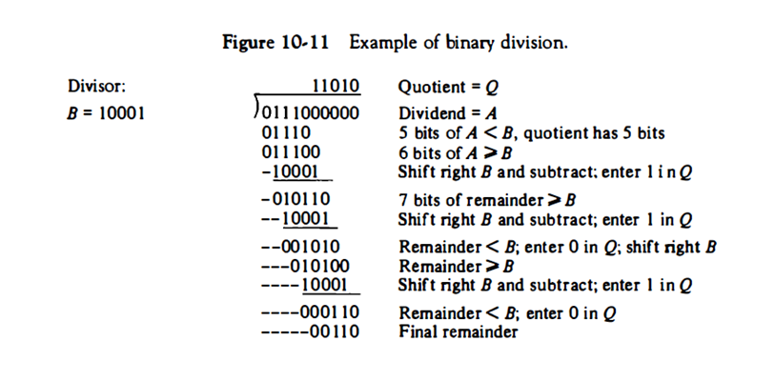
EXAMPLE OF A SIMPLE BINARY DIVISION
The Divisor B consist of five bits and the dividend A of ten bits.
Five MSB(Most Significant Bits) of the dividend are compared with the divisor.
We notice that 5-bit number is smaller than B , we will try again by taking 6 MSB of A and compare it with B.
The 6-bit number is greater than B, so we place 1 for the quotient bit in the sixth position, above the dividend.
The divisor is then shifted right and subtracted from the dividend.
The difference is called PARTIAL REMAINDER.
If the partial remainder is greater than or equal to the divisor, the quotient bit is equal to 1.
The divisor is then shifted right and subtracted from the partial remainder.
If partial remainder is smaller than the divisor, the quotient bit is 0 and no subtraction is needed.
The divisor is shifted once to the right in any case.

Slide 4
HARDWARE IMPLEMENTATION FOR SIGNED-MAGNITUDE DATA
Implementing division in digital computers is quite different.
Instead of shifting the divisor to the right, the dividend or the partial remainder is shifted to left thus leaving two numbers in the relative position.
Subtraction may be achieved by adding A to two’s complement of B.
The hardware for implementing the division algorithm is identical to that required for multiplication and requires the same components.

Slide 5
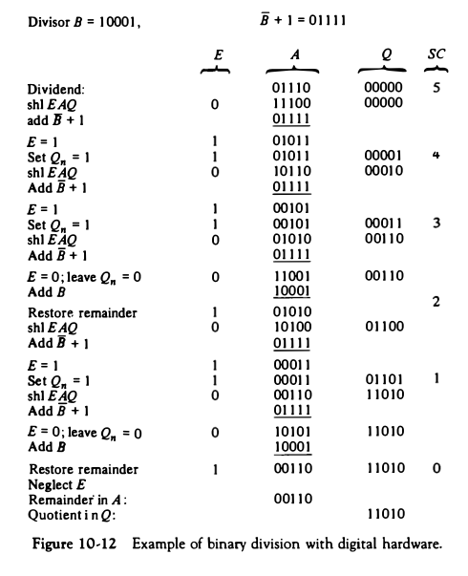
EXAMPLE OF HARDWARE IMPLEMENTATION
The divisor is stored in the B register and the double-length dividend is stored in registers A and Q.
The dividend is shifted to the left and the divisor is subtracted by adding its 2' s complement value.
The information about the relative magnitude is available in E. If E = 1, it signifies that A >= B. . If E = 0, it signifies that A < B so the quotient in Q, remains a 0.
A quotient bit 1 is inserted into Q, and the partial remainder is shifted to the left to repeat the process.
The value of B is then added to restore the partial remainder in A to its previous value.
The partial remainder is shifted to the left and the process is repeated again.

Slide 6
THANK YOU!!

